Slide 1
Employee Data Analysis using Conditional Formatting
STUDENT NAME: KIRAN V
REGISTER NO: 312200517, 105312200517
DEPARTMENT: III B.COM, COMMERCE
COLLEGE: PACHAIYAPPAS COLLEGE FOR MENS, KANCHIPURAM.

Slide 2
PROJECT TITLE
Employee Performance Analysis using Conditional Fomatting

Slide 3


AGENDA
Introduction
Understanding Employee Performance Metrics
Our Solution and Proposition
Dataset Description
Modelling Approach
Results and Discussion
Conclusion
3/21/2024 Annual Review

Slide 4

PROBLEM STATEMENT
Organizations often face challenges in effectively analyzing and visualizing employee performance data. Traditional methods of reviewing performance data can be time-consuming and may not provide clear insights into individual or team performance. This lack of clarity can lead to difficulties in identifying top performers, recognizing areas for improvement, and making data-driven decisions regarding promotions, training, and resource allocation.

Slide 5

PROJECT OVERVIEW
The project aims to enhance employee performance analysis by using conditional formatting to visually represent performance data, making it easier to identify top performers, underperformers, and trends at a glance. By collecting and organizing relevant performance metrics (such as sales targets, project completion rates, and customer satisfaction), we will apply conditional formatting techniques in tools like Excel or Google Sheets to create clear, intuitive visuals. These visuals will help managers and HR teams quickly analyze performance, make informed decisions, and provide targeted support or recognition to employees. The project will also include developing interactive dashboards, creating documentation, and providing training to ensure stakeholders can effectively use these tools to drive data-driven decisions, improve productivity, and support employee growth.

Slide 6
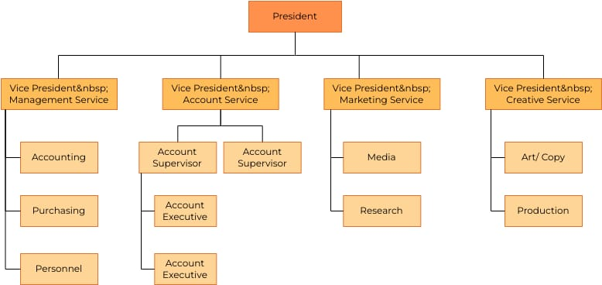

WHO ARE THE END USERS?

Slide 7

OUR SOLUTION AND ITS VALUE PROPOSITION
1. Improved Decision-Making - By providing a quick and clear view of performance data, stakeholders can make more informed decisions regarding promotions, training needs, and resource allocation.
2. Time Efficiency - Conditional formatting reduces the time spent on manual data analysis and reporting, allowing managers to focus on strategic activities rather than data crunching.
3. Enhanced Employee Development - By easily identifying high and

Slide 8
Dataset Description
Employee dataset = Kaggle platform
26 features are there in this dataset
I choose to consider only 8 features

Slide 9

THE "WOW" IN OUR SOLUTION
Level of performance =IFS formula
3/21/2024 Annual Review

Slide 10
MODELLING
Data collection
Download employee dataset in kaggle platform
Then insert in this dataset to excel
Feature collection
Identify the data like employee id, firstname, lastname, business unit,
Gender code, performance
Data cleaning
Identify the missing values
Filter out the missing values
Performance level
Identify the employee performance using the IFS formula
Summary
Using pivot table to filtering the features
Visualization
Insert the column graph
To visualize the employee performances

Slide 11
RESULTS
Employee Performance Analysis

Slide 12
conclusion
Overall, this method supports a more efficient and transparent performance management process, fosters a data-driven culture, and ultimately contributes to improved productivity and employee engagement. Regular updates and refinements to the model ensure it remains aligned with evolving business goals and organizational needs, maximizing its value over time. By leveraging conditional formatting, organizations can turn raw data into actionable insights, driving better outcomes for both employees and the business.

